Slide 1
Agentic Complimentary Disruption Concierge (ACDC)
RAG-gedy Anns presents:
United Airlines & University of Chicago Hackathon

Slide 2









Our Team
Our Team
Veera Anand
M.S. ADS @ UChicago
B.S. Neuro Sci @ UChicago
Anusha Bhat
M.S. ADS @ UChicago
B.S. Stat & ML @ CMU
Devyani Mahajan
M.S. ADS @ UChicago
B.A. Cog Sci @ Swarthmore
Bruna Medeiros
M.S. ADS @ UChicago
B.S.B.A @ Babson College
Peyton Nash
M.S. ADS @ UChicago
B.A. Econ @ Bard College
Kyler Rosen
M.S. ADS @ UChicago
B.S. CS @ CWRU
Kevin Zhou
ML Intern @ United Airlines
B.S. CS & Stat @ UIUC

Slide 3
Agenda
Problem Statement
Our Solution
Data
Architecture
Risk
Future Vision

Slide 4
In November 2024, United Airlines customers waited up to 4 hours on hold. The industry average was 21 minutes.
Source: Mighty Travels
Notes:
To contextualize the problem we’re trying to solve…

Slide 5


Rapid access to customer service would improve the experience for travelers and United agents
When Paul's flight was delayed:
When Susana’s flight was cancelled:
He waited at the gate with no updates for the first 90 minutes
Missed his connecting flight to Boston, forcing him to rebook through a different city
Arrived 6 hours late, missing his daughter's graduation ceremony
She stood in a 2-hour line at customer service with 200+ other passengers
Had to find her own hotel room and transportation, with no guidance from United
Lost a full day of her vacation and paid out-of-pocket expenses
Customer service agents often struggle to resolve flight disruptions efficiently and effectively, costing airlines between $25B and $35B annually.
Source: Digital Travel Summit APAC 2025
Notes:
These response times can have major impacts on customers and United employees. When Paul’s flight was delayed, he missed his connection and a major life event because he didn’t have the information he needed to make informed choices
When Susana’s flight was cancelled she waited in a line for hours and ultimately lost a day of vacation and paid out-of-pocket
Customer service agents often struggle to resolve flight disruptions efficiently and effectively which has major financial impacts

Slide 6
Our Solution: An AI-Powered Flight Disruption Assistant
When a flight is cancelled or delayed, a dedicated chatbot appears in the United Airlines app, that:
Instantly analyzes:
Customer Service:
Flight details
Passenger details
Customer Effort Score (CES)
Customers get immediate access with minimal effort vs. putting effort into solving problems themselves
First Response Time
24/7 immediate access vs. waiting for human agents
Customer Retention Rate
Better experience reduces churn
Current flight
Alternative flights
Destination
Passenger status
Lounge Access
2) Provides personalized responses:
1
Optimal rebooking options for individuals and families
Operations:
Utilization Rate
Agents can perform complex rebooking tasks, improving aircrew utilization efficiency
2
Recommendations for hotels
3
Airport lounge access
Employee Performance KPIs
4
Compensation eligibility and next steps
Service Quality
Human attendants are less overwhelmed and pressured during disruptions, leading to better service delivery
Notes:
Our solution is an AI powered disruption assistant that appears as a chatbot in the United Airlies app when a flight is delayed or cancelled

Slide 7
Data is synthesized or collected from several sources
Flight Data
Hotel and Lounge Data
United Airlines Unstructured Data
Flight data from Aviation Stack API
Synthetic customer data
Random assignments of customers to flights
Synthetic hotels data based on United's Hotel Partners
Scraped United lounge data
Scraped Priority Pass lounge data
Contract of Carriage
Mileage Plus Rules
Lounge Terms and Conditions
Notes:
The data this agent uses is synthesized or collected from several sources

Slide 8
Architecture: 2 Agents, 9 Tools
1
Event Listener
Captures disruption events
2
Profile Service
Gets customer info
2 agents: MCP Agent & Options Builder agent
MCP Agent:
Runs all 9 tools in sequence from event capture to the result
Analyzes customer sentiment after showing options
Loops back to reprocess with better alternatives if customer appears upset
Options Builder Agent:
Receives customer and flight context from MCP Agent
Decides which specific tools to call (flights, hotels, lounges)
Returns curated list of alternatives back to MCP Agent
3
Context Aggregator
Gets flight data
4
Delay Explainer
Translates delay codes
5
Rules & Policy Engine
Applies compensation rules
6
Options Builder Agent
Finds alternative options
7
Options Evaluator
AI ranks options
8
Sentiment & Escalation Manager
Detects customer sentiment
9
Result
Returns a flight option to rebook

Slide 9
Architecture: 2 Agents, 9 Tools
1
Event Listener
2
Profile Service
3
Context Aggregator
4
Delay Explainer
The MCP agent can loop back to reprocess with better alternatives, hoping that the customer prefers the new response
5
Rules & Policy Engine
6
Options Builder Agent
7
Options Evaluator
8
Sentiment & Escalation Manager
Escalation based on the sentiment of the passenger’s response
9
Result

Slide 10
Architecture: 2 Agents, 9 Tools
1
Event Listener
2
Profile Service
3
Context Aggregator
4
Delay Explainer
5
Rules & Policy Engine
The Options Builder Agent conducts its own agentic workflow to find available hotels, lounges and flights for each individual passenger
6
Options Builder Agent
7
Options Evaluator
8
Sentiment & Escalation Manager
9
Result

Slide 11
Risk
Process Risk
Risks:
Give wrong recommendations (suggesting full flights, unavailable hotels, excessive compensation)
AI suggests impossible connections or unrealistic options
Mitigation:
Add real-time availability checks
Require human approval for high-value recommendations
Data Risk
Legal & Compliance Risk
Risks:
Mishandling customer data: attaching wrong passenger info to the wrong customer
Showing incorrect flight details or loyalty status
Mitigation:
Use unique customer IDs and flight IDs for all database lookups
Add validation checks to confirm customer matches flight booking
Risks:
App doesn't work for visually impaired customers (ADA violation)
No disclosure that customers are interacting with AI
Mitigation:
Add screen reader compatibility; display "AI-generated recommendations" disclaimers
Risks
Use Risk
Third-Party Risk
Risks:
Customers fake angry messages to manipulate premium support treatment
Mitigation:
Monitor escalation patterns; weight loyalty tier more heavily than sentiment
Risks:
Customer data sent to external AI companies
System fails if AI services go down
Mitigation:
Sign data processing agreements with AI vendors
Build backup systems for AI outages
*American with Disabilities Act

Slide 12
Future Vision and Improvements
Customer Data Integration
External API Integration
Credit Card Detection: Identify card type from number to unlock lounge access and benefits
Visa Restrictions: Passport/nationality checking for international hotel options
Employee Priority: Operational importance weighting for United staff
Weather API: Predictive forecasting to identify at-risk flights 6+ hours ahead
News API: Real-time correlation between weather events and operational impacts
Live Transportation: Ground transport options and pricing for multi-city solutions
Partnership Data Sources
Customer Data Integration
Star Alliance Integration: Rebooking options across partner airlines
Hotel/Rental Partners: Direct booking capabilities with preferred rates
Nearby Airports: Alternative routing through secondary cities with ground transport
Advanced Sentiment: Priority-based escalation with cultural context
Real-time Inventory: Live seat availability across all options

Slide 13
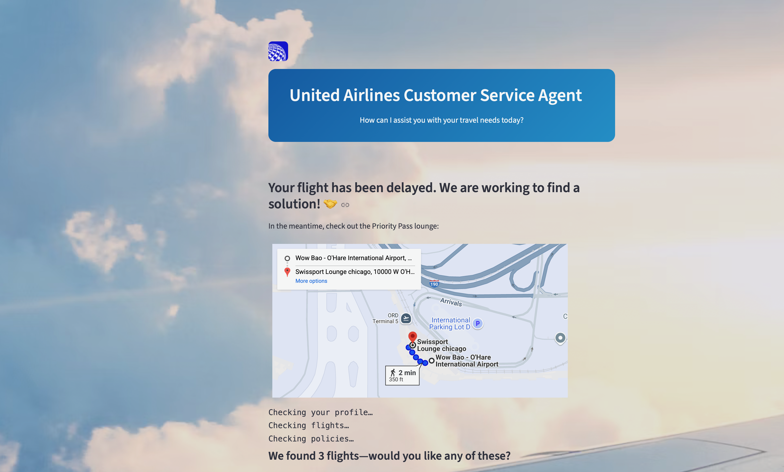
Future Vision and Improvements

Slide 14
Thank You, Questions?

Slide 15
Appendix

Slide 16
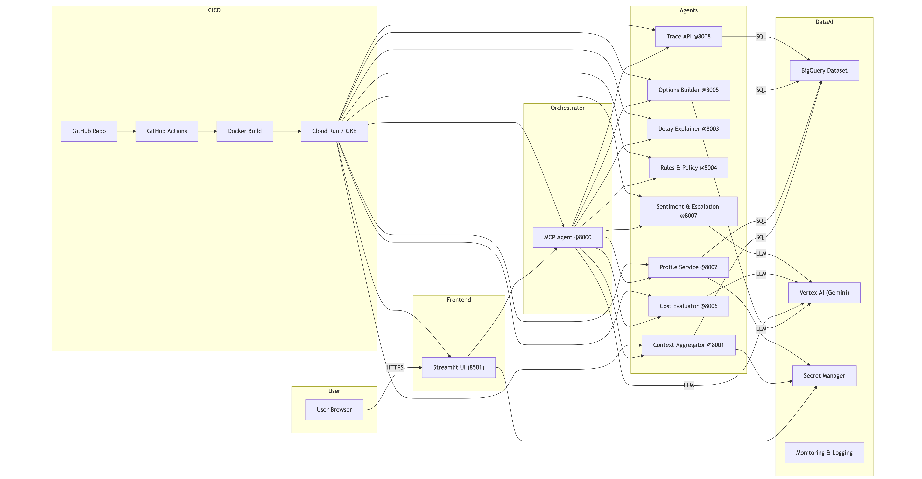

Slide 17
Architecture: Additional Information
Architecture Overview
Built using LangChain and LangGraph workflow framework
Google Cloud Platform (GCP) for infrastructure
Integrated MCP (Model Context Protocol) servers within the LangGraph workflow
AI Framework & Tools
Primary Framework: LangChain with LangGraph for workflow orchestration
LLM: Gemini 2.5 Pro
Architecture Pattern: Supervisor-based LangGraph architecture
Data & Retrieval
RAG Implementation: Used in select microservices
Knowledge Sources: BigQuery integration with structured tables & unstrcutured texts in tables
Server Integration
MCP Servers: Integrates directly with the LangGraph workflow for seamless data access and processing

Slide 18
Roadmap to Production: Deployment & Maintenance Over Time
Migration to MARS
Incorporate Real-Time
Data Updates
Full Deployment
In-App

Slide 19
Data Synthesization Process
Customers
Hotels
Flights and Booking
Generated primarily by ChatGPT based on SQL table
Priority Pass lounge access is randomly assigned to 40% of passengers
Randomly assigns 6 to 20 of United Airlines hotel partners to each airport
Stars, distance from the airport and the number of open rooms are randomly determined
Number of available seats and IATA delay codes are randomly assigned
Customers are randomly assigned to flights
Party size is assigned from 1 to 4

